Slide 2



Slide 3


Slide 4
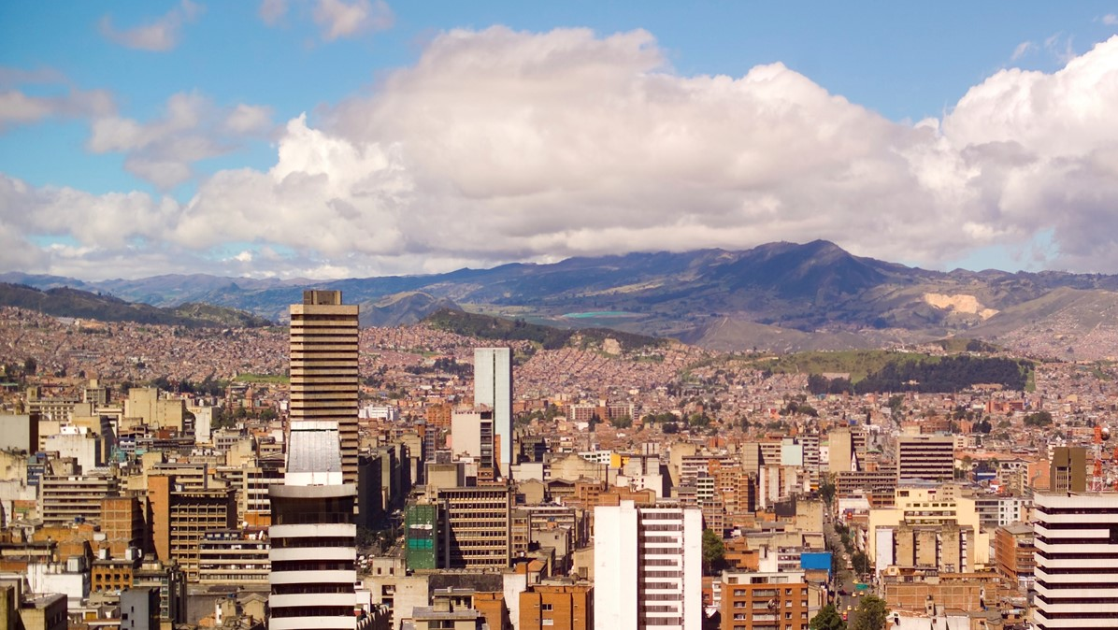

Mapathon Introduction

Slide 5
Welcome
Thanks for attending the 2018 National Volunteer Week mapathon
While you are waiting for others to arrive, complete the below steps:
Sign up for an account at www.openstreetmap.org
Check your email and confirm your account by clicking the link provided!
Read through the steps on the guide on your table, to get familiar with how to map

Slide 6
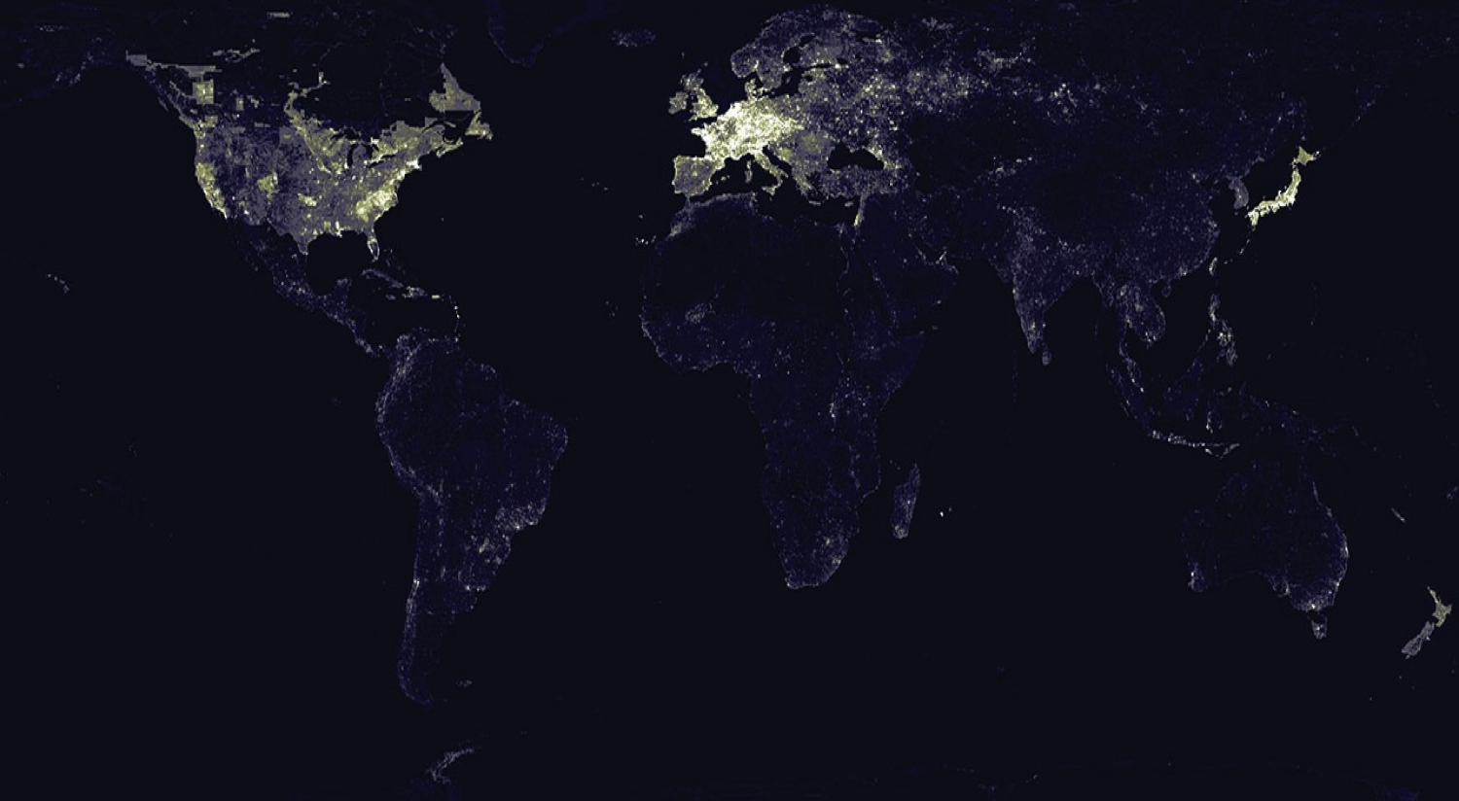
Most of the developing world’s population is not on any map.

Slide 7
What is mapping and why do it?
Aim: Creating digital maps of the world’s ‘forgotten’ places by crowdsourcing. Described as
‘the human genome project for international development’.
Why: Many parts of the world most vulnerable to humanitarian crises such as natural disasters, disease outbreaks, epidemics or conflict are not mapped. People have limited/ no visibility to the situation on the ground.
Process:
Remote volunteers trace maps over satellite pictures, using a tool called OpenStreetMap
The maps are validated by remote experienced mappers
The maps are validated locally by volunteers, and details e.g. place names, identifying hospitals are added (project dependent)
Humanitarian organizations can then use mapped information to plan risk reduction and disaster response activities that save lives

Slide 8












When you map, you’re solving real world data challenges for NGOs, helping with:
Medical supplies
+ logistics
Infectious diseases e.g. Ebola
Vaccination campaigns
Waterborne diseases e.g. cholera
Malnutrition
Earthquakes
Hurricanes
Flooding
Missing Maps founders:

Slide 9
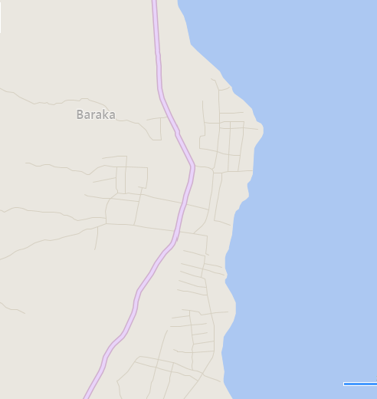
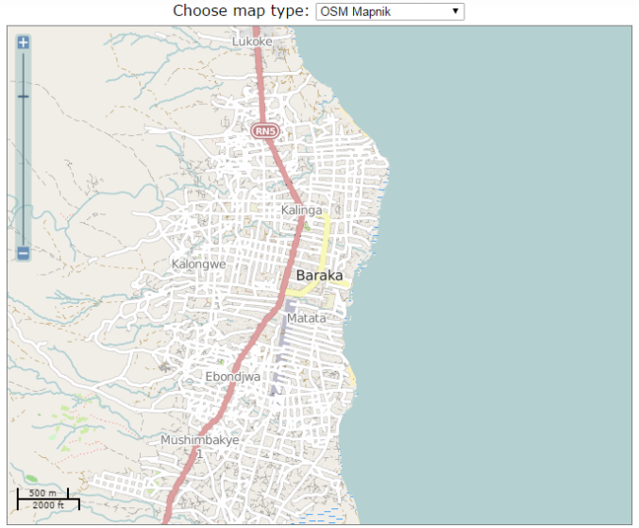
The impact of mapathons
This is a thriving trading city of 120,000 people – mapped in just one evening by 70 people!
Bing maps still (to this date) shows no buildings in the area, whereas Open Street Map has thousands of buildings on an open source platform for all NGOs to use.
To see the below for yourself and zoom in to see the individual buildings mapped, click here
Open Street Map
Now
Bing Maps Now

Slide 10
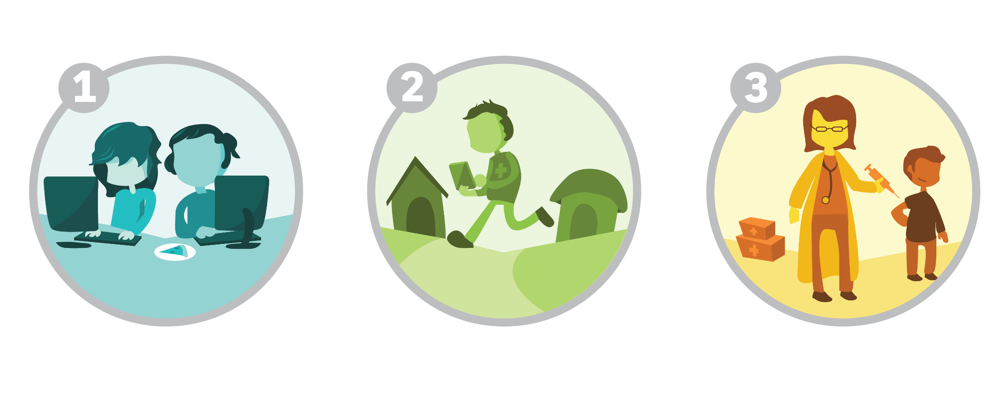
Missing Maps’ three-step process
Digital volunteers use satellite imagery to trace buildings and roads, adding this base data into OpenStreetMap, a free and editable map of the world.
Community volunteers learn about the map and add local detail such as schools, health facilities, street names, and evacuation centers.
Humanitarian organizations use mapped information to plan risk reduction and disaster response activities to save lives. Better data enables more efficient interventions.
Notes:
Joint project with the BRC, MSF, HOT (explain what that is). Started in late 2014 with the goal of putting 20 M on the map by 2017.

